Slide 1
Inference for
a Single Proportion

Slide 2
Multiple choices
Two scientists want to know if a certain drug is effective against high blood pressure. The first scientist wants to give the drug to 1000 people with high blood pressure and see how many of them experience lower blood pressure levels. The second scientist wants to give the drug to 500 people with high blood pressure, and not give the drug to another 500 people with high blood pressure, and see how many in both groups experience lower blood pressure levels. Which is the better way to test this drug?
All 1000 get the drug
500 get the drug, 500 don’t

Slide 3
Multiple choices
Two scientists want to know if a certain drug is effective against high blood pressure. The first scientist wants to give the drug to 1000 people with high blood pressure and see how many of them experience lower blood pressure levels. The second scientist wants to give the drug to 500 people with high blood pressure, and not give the drug to another 500 people with high blood pressure, and see how many in both groups experience lower blood pressure levels. Which is the better way to test this drug?
All 1000 get the drug
500 get the drug, 500 don’t

Slide 4
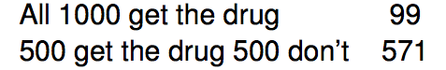
Results from the GSS
The GSS asks the same question, below is the distribution of 670 responses from the 2010 survey:

Slide 5
Parameter and point estimate
Parameter of interest: proportion of all Americans who have good intuition about experimental design.
p a population proportion
Point estimate: proportion of sampled Americans who have good intuition about experimental design.
p̂ a sample proportion

Slide 6
Inference on a proportion
What percent of all Americans have good intuition about experimental design, i.e. would answer "500 get the drug 500 don't"?

Slide 7
Inference on a proportion
What percent of all Americans have good intuition about experimental design, i.e. would answer "500 get the drug 500 don't"?
We can answer this research question using a confidence interval, which we know is always of the form
point estimate ± ME

Slide 8

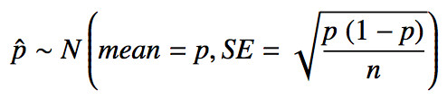
Sample proportions are also nearly normally distributed
Central limit theorem for proportions
Sample proportions will be nearly normally distributed with mean equal to the population mean, p, and standard error equal to
But of course this is true only under certain conditions…

Slide 9
Sample proportions are also nearly normally distributed
Central limit theorem for proportions
Sample proportions will be nearly normally distributed with mean equal to the population mean, p, and standard error equal to
But of course this is true only under certain conditions…
independent observations, at least 10 successes and 10 failures

Slide 10
Back to experimental design...
The GSS found that 571 out of 670 (85%) of Americans answered the question on experimental design correctly. Estimate (using a 95% confidence interval) the proportion of all Americans who have good intuition about experimental design?

Slide 11
Back to experimental design...
The GSS found that 571 out of 670 (85%) of Americans answered the question on experimental design correctly. Estimate (using a 95% confidence interval) the proportion of all Americans who have good intuition about experimental design?
Given: n = 670, p̂ = 0.85. First check conditions.

Slide 12
Back to experimental design...
The GSS found that 571 out of 670 (85%) of Americans answered the question on experimental design correctly. Estimate (using a 95% confidence interval) the proportion of all Americans who have good intuition about experimental design?
Given: n = 670, p̂ = 0.85. First check conditions.
Independence: The sample is random, so we can assume that one respondent's response is independent of another.
Success-failure: 571 people answered correctly (successes) and 99 answered incorrectly (failures), both are greater than 10.

Slide 13
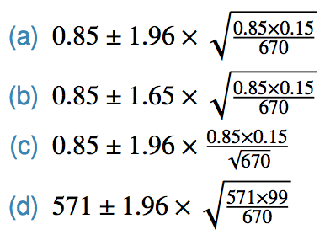
Practice
Which of the below is the correct calculation of the 95% confidence interval?

Slide 14
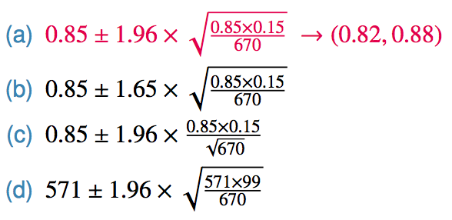
Practice
Which of the below is the correct calculation of the 95% confidence interval?

Slide 15
Choosing a sample size
How many people should you sample in order to cut the margin of error of a 95% confidence interval down to 1%.

Slide 16

Choosing a sample size
How many people should you sample in order to cut the margin of error of a 95% confidence interval down to 1%.

Slide 17
Choosing a sample size
How many people should you sample in order to cut the margin of error of a 95% confidence interval down to 1%.

Slide 18


Choosing a sample size
How many people should you sample in order to cut the margin of error of a 95% confidence interval down to 1%.

Slide 19
Choosing a sample size
How many people should you sample in order to cut the margin of error of a 95% confidence interval down to 1%.

Slide 20
Practice
The GSS found that 571 out of 670 (85%) of Americans answered the question on experimental design correctly. Do these data provide convincing evidence that more than 80% of Americans have a good intuition about experimental design?

Slide 21
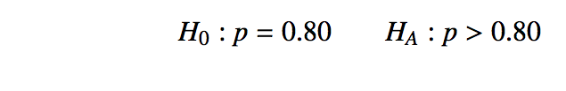
Practice
The GSS found that 571 out of 670 (85%) of Americans answered the question on experimental design correctly. Do these data provide convincing evidence that more than 80% of Americans have a good intuition about experimental design?

Slide 22


Practice
The GSS found that 571 out of 670 (85%) of Americans answered the question on experimental design correctly. Do these data provide convincing evidence that more than 80% of Americans have a good intuition about experimental design?

Slide 23

Practice
The GSS found that 571 out of 670 (85%) of Americans answered the question on experimental design correctly. Do these data provide convincing evidence that more than 80% of Americans have a good intuition about experimental design?

Slide 24
Practice
The GSS found that 571 out of 670 (85%) of Americans answered the question on experimental design correctly. Do these data provide convincing evidence that more than 80% of Americans have a good intuition about experimental design?
Since the p-value is lower than 0.05, we reject H₀. The data provide convincing evidence that more than 80% of Americans have a good intuition on experimental design.

Slide 25
Practice
11% of 1,001 Americans responding to a 2006 Gallup survey stated that they have objections to celebrating Halloween on religious grounds. At 95% confidence level, the margin of error for this survey is ±3%. A news piece on this study's findings states: "More than 10% of all Americans have objections on religious grounds to celebrating Halloween." At 95% confidence level, is this news piece's statement justified?
Yes
No
Can’t tell

Slide 26
Practice
11% of 1,001 Americans responding to a 2006 Gallup survey stated that they have objections to celebrating Halloween on religious grounds. At 95% confidence level, the margin of error for this survey is ±3%. A news piece on this study's findings states: "More than 10% of all Americans have objections on religious grounds to celebrating Halloween." At 95% confidence level, is this news piece's statement justified?
Yes
No
Can’t tell

Slide 27

Recap - inference for one proportion
Population parameter: p, point estimate: p̂
Conditions
Independence
at least 10 successes and 10 failures
Standard error:
for CI: use p̂
for HT: use p in H₀

